Slide 1
Secure data hiding in images using steganography
CAPSTONE PROJECT
Presented By : Kandula Sri Samyuktha Reddy
Student Name : Kandula Sri Samyuktha Reddy
College Name & Department : Anurag Engineering college
(Eletronics and Communication Engineering)

Slide 2
OUTLINE
Problem Statement
Technology used
Wow factor
End users
Result
Conclusion
Git-hub Link
Future scope

Slide 3
Problem Statement
This project implements LSB Steganography to embed secret data within images, ensuring confidentiality without noticeable distortion.
Developed using Python, with libraries like OpenCV, NumPy, and PIL, running on Jupyter Notebook/Google Colab.
Provides high security by combining encryption with steganography, supports multiple image formats (PNG, BMP, JPEG), and ensures lossless extraction.
Useful for government, cybersecurity, journalists, and individuals needing secure communication and data protection.
Scope for AI-based steganalysis detection, adaptive steganography, real-time applications, and expansion to audio/video formats.

Slide 4
Technology Used
Libraries:
Open cv- For image processing and manipulation.
Numpy- For handling numerical operations and pixel modifications.
Matplotlib - For visualizing images before and after steganography.
Tools & Platforms:
Python.
Google Colab.

Slide 5
Wow factors
Uses LSB Steganography to conceal secret data in image pixels without noticeable changes.
Enhances security with additional encryption before embedding
Supports multiple image formats like PNG, BMP, and JPEG.
Extracts hidden data without loss or distortion.
User-friendly GUI (optional, if implemented)

Slide 6
End users
Government & Defense: Secure transmission of classified information.
Journalists & Activists: Concealing sensitive communication.
General Users: Secure personal data sharing.
Cybersecurity Firms: Research & forensic analysis.

Slide 7
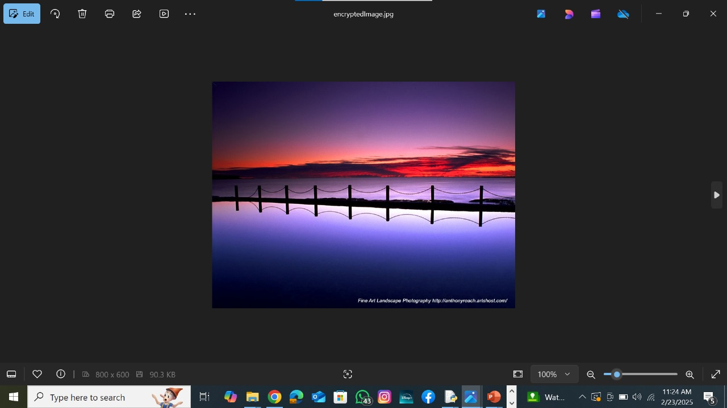
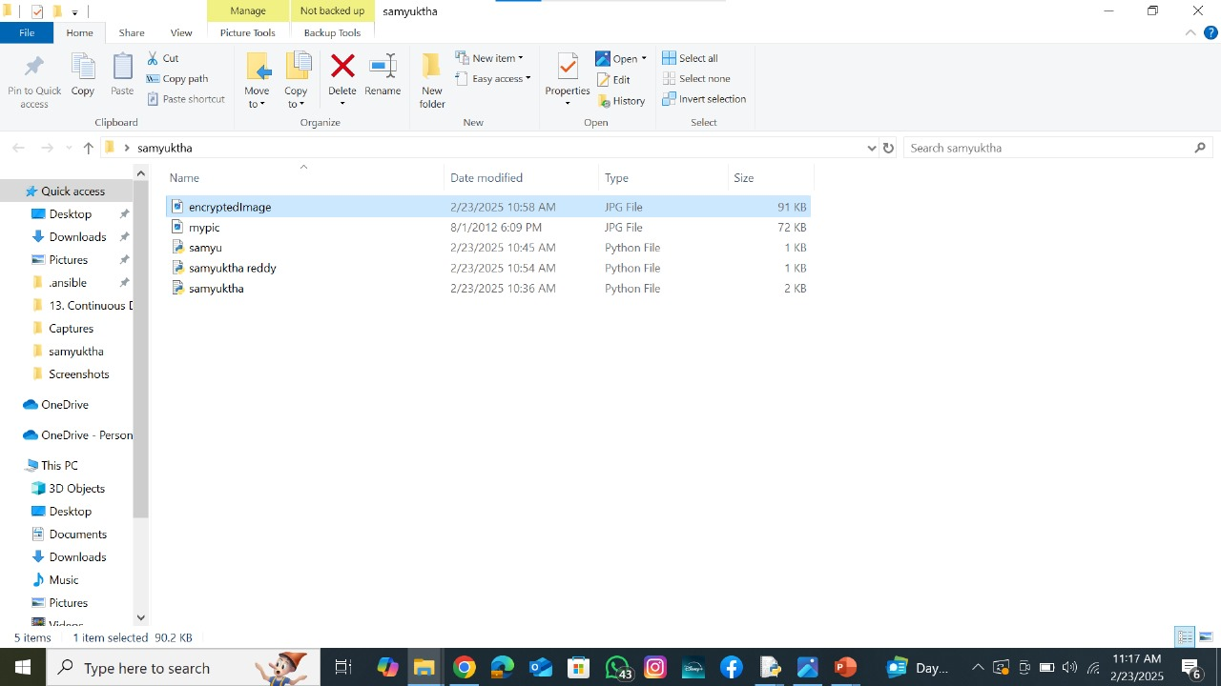
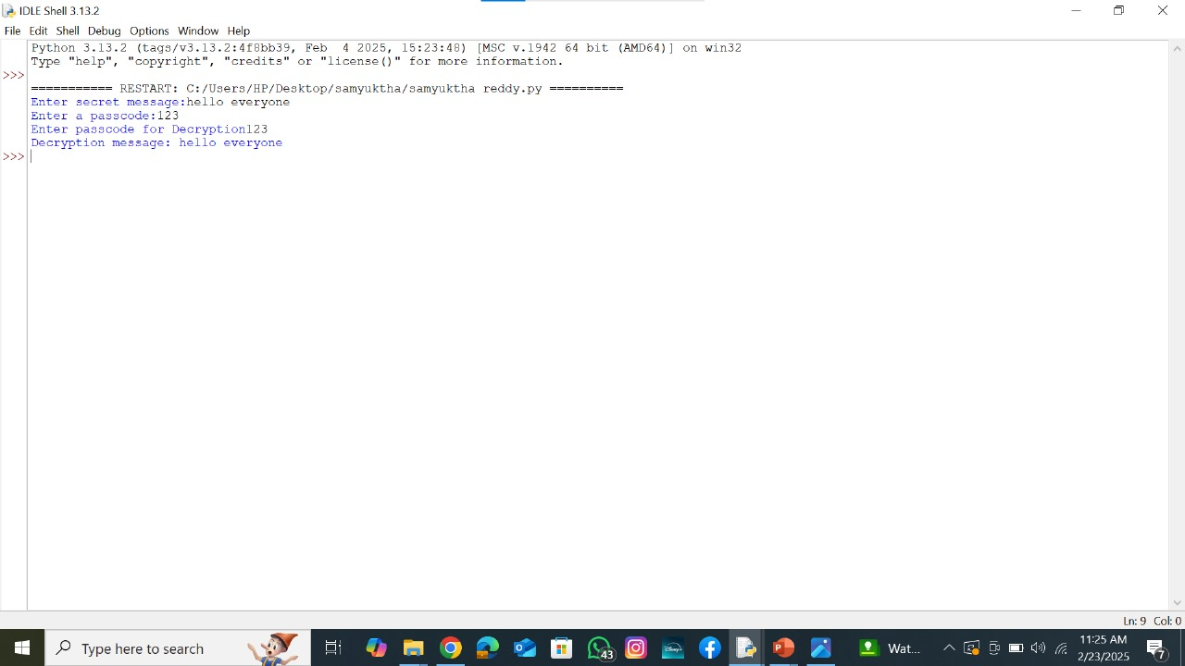
Results

Slide 8
Conclusion
Implementation of LSB Steganography for securely embedding data within images.
Ensures robust and efficient data concealment with high security.
Maintains confidentiality and integrity during data transmission.
Effective data hiding with no visible distortion in the stego-mage.

Slide 9
GitHub Link
https://github.com/samyukthareddykandula/stego.git
Description:
This project implements Least Significant Bit (LSB) steganography to hide and extract secret messages within BMP images.
Repository Contents:
Source Code – python programs for embedding and extracting hidden messages.
Sample Images – BMP images used for testing steganography.
Documentation – Project report, explanations, and implementation details.
Presentation – PPT slides summarizing the project.

Slide 10
Future scope(optional)
Real-time Preview – Show a preview of the image before and after steganography is applied.
Drag and Drop Support – Allow users to select images and messages through a simple drag-and-drop interface.
Graphical User Interface (GUI) – Develop a user-friendly GUI to make embedding and extracting messages easier.
Customization Options – Provide settings for users to adjust the encoding method and choose different bit depths.

Slide 11
THANK YOU

